Slide 1

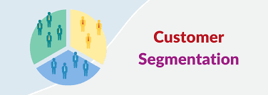
DESCRIPTIVE ANALAYSIS
CUSTOMER SEGMENTATION USING CLUSTERING TECHINIQUES
TEAM NUMBER -02
TEAM MEMBERS
K.NIKHIL[9921004374]
K.V.S.SAI RAM SANTOSH BABU[9921004355]
K. HARI KRISHNA[99210041214]
C. SAI PRATHAP REDDY[99210041713]
Faculty Guide- Mrs. N. Kirthiga
Department of computer science and engineering

Slide 2
Problem Statement
Customer segmentation is crucial for understanding the diverse customer base of a business. By grouping customers with similar characteristics together, companies can tailor marketing strategies, product offerings, and customer experiences to meet the specific needs of each segment. This analysis involves utilizing data such as purchase history, age, location, buying frequency, and preferences to identify patterns. It might involve techniques like clustering algorithms to auto-matically group customers or creating personas that represent each segment. The resulting in-sights can guide personalized marketing campaigns and customer retention strategies.

Slide 3
Abstract
Customer segmentation process is a separation of the types of consumers/customers are visited to the mall/market/shopping complex. i, e., segregating multiple distinct groups of customers who shares their similar characteristics.
The segmentation of mall is the potent way of representing and defining the customer needs.
Managing the customer relationship will always play the important/crucial role to supply business intelligence to build, manage and develop valuable interminable consumer/buyer relationship/connections.
This will help in the business for ideas to develop the relationship with customer with smooth manner

Slide 4
Customer Segmentation
Customer Segmentation is a popular application of unsupervised learning.
Using clustering, identify segments of customers to target the potential user base. They divide customers into groups according to common characteristics like gender, age, interests, and spending habits so they can market to each group effectively.
Based on this clustering malls get an idea to make changes according the features of costumers

Slide 5
Literature Survey
Paper Details | Description
Customer Segmentation based on RFM model and Clustering Techniques With K-Means Algorithm Ina Maryani , Dwiza Riana , Rachmawati Darma Astuti , Ahmad Ishaq, Data mining process based on RFM model and by using techniques Clustering (2018) | segmentation of customers from the transaction data based on RFM(Recency, Frequency, and monetary) model, and furthermore clustering analysis was performed by using K-Means model
Estimating Customer Segmentation based on Customer Lifetime Value Using Two-Stage Clustering Method ,Pradnya Paramita Pramono ,Isti Surjandari , Enrico Laoh ,Two-stage clustering method for segmenting customers using LRFM (2019) | It categorizes its large amounts of customers, with customers in the same category possessing similar attributes and customers in different categories possessing different attributes based on Ward’s method to specify number of cluster and K-Means clustering
Maximizing Strategy Improvement in Customer Segmentation using Clustering, Musthofa Galih Pradana , Hoang clustering using machine learning(2021) | Customer segmentation is possible by machine learning it is very profitable in the industry because a manager can pay full attention to handling each cluster

Slide 6
Introduction to Problem Statement
To make predictions and ﬁnd the clusters of potential customers of the mall and thus ﬁnd appropriate measures to increase the revenue of the mall is one of the prevailing applications of unsupervised learning.
For example, a group of customers have high income but their spending score (amount spent in the mall) is low so from the analysis we can convert such type of customers into potential customers (whose spending score is high) by using strategies like better advertising, accepting feedback and improving the quality of products.

Slide 7
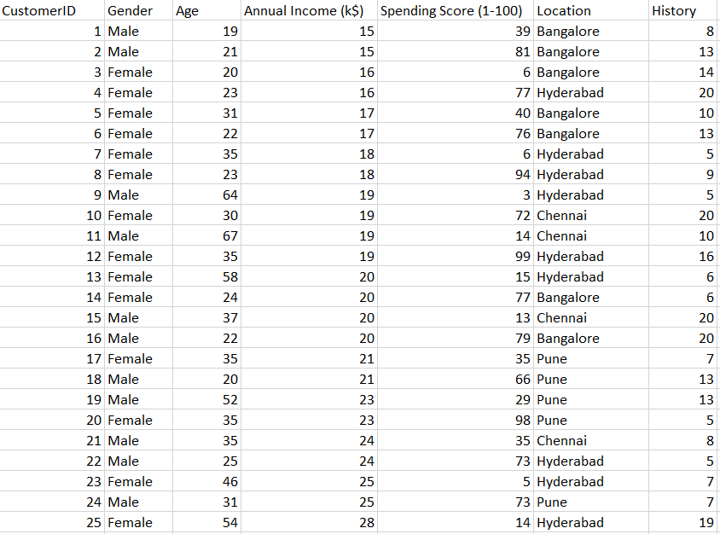
Data Set Overview
The dataset name is Mall_Customers.csv consists of 5 columns which are CustomerID, Gender, Age, Annual Income (k$), Spending Score (1-100), Location, History where Gender is a categorical value and rest all features are numeric.
The size of the dataset is (200, 7) which is 200 rows and 7 columns.

Slide 8
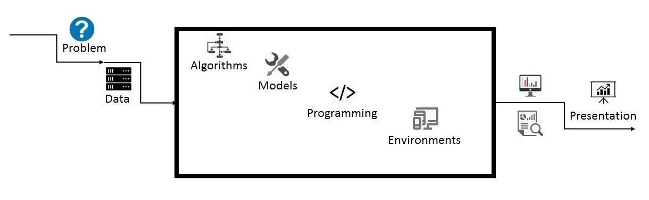
Architecture Overview

Slide 9
Project Architecture
Data: The size of the dataset is (200, 7) which is 200 rows and 7 columns. Also, on dataset does not contain any NULL or Na values.
Algorithms: K-means, Hierarchical, DB-scan
Model:
K-means model is used and is hyper tuned parameters like n_clusters=5 using elbow method to ﬁnd the optimal number of clusters also init=’k-means++’ to avoid random initialization trap.
Hierarchical cluster uses the dendrogram and find the possible clusters
Density Based clustering clusters data based on the densities of them and finds outliners effeciently
Programming Language: Python
Environment (Libraries and Technologies): Numpy, Pandas, Matplotlib, Seaborn, Jupyter Notebook, Google Colab.

Slide 10
Clustering
Clustering is known as a method for identifying common groups in a data set. The entities in each group are comparatively more similar to entities from that group than to other group entities.
Since the 70s, cluster-based segmentation has been used very often in various studies involving data, especially in marketing.
As stated by that clustering is not a structured method of data analysis, even though it has good flexibility, it really depends on the data or sample used.
A statistical approach used by some studies with cluster analysis by it is called the "tandem method" consisting of two processes the first is factor analysis and the second is performing cluster analysis.

Slide 11
This approach has been heavily criticized by several other articles. It is all caused by a key problem in its method, namely preliminary factor analysis can destroy existing cluster structures.
As an alternative to the tandem method, hierarchical cluster analysis can be used as an alternative by using binary variables. However, the reliability of this method was highly questioned by many researchers at its time and nonhierarchical methods have been very dominant since the 80s.
Clustering are many types some of them are
K- Means Clustering
Hierarchical Clustering
Density- Based Clustering

Slide 12
K- Means Clustering
K-means clustering is an algorithm which is used to perform the mall basket analysis which comes under the category Unsupervised learning
The main agenda is to companies need the customer data to know the better feature of the customer.
By the K-means clustering customer segmentations will helps in figuring out the consumers who differ in the terms of expectations, desires, attributes and preferences.
The important use of customer segmentation is to be grouping the customers with similar interests and needs which helps the marketing team to implement effective marketing strategy plan.

Slide 13
Hierarchical Clustering
Hierarchical clustering is a method of clustering analysis that groups similar objects into clusters based on their similarities and differences
The two main types of hierarchical clustering are agglomerative clustering and divisive clustering
In agglomerative clustering, each data point is initially considered as a separate cluster, and then, at each iteration, the two closest clusters are merged together, until all the data points are grouped into a single cluster
In divisive clustering, all the data points are initially grouped into a single cluster, and then, at each iteration, the cluster is split into two smaller clusters, until each data point is in a separate cluster

Slide 14
Density- Based Clustering
Density-based clustering is a clustering technique that groups together data points based on their density in a high-dimensional space
It is commonly used to identify clusters of arbitrary shape in a dataset and is particularly useful when the clusters have varying densities or are separated by noisy or sparse regions.
One of the most popular density-based clustering algorithms is DBSCAN DBSCAN works by defining two parameters: epsilon (ε) and minimum number of points (minPts).
The algorithm first identifies "core" points that have at least minPts points within a distance of ε. These core points form the center of a cluster, and any points within ε distance of them are added to the same cluster. Points that are not core points and are not within ε distance of any core points are considered noise points. Another density-based clustering algorithm is OPTICS

Slide 15
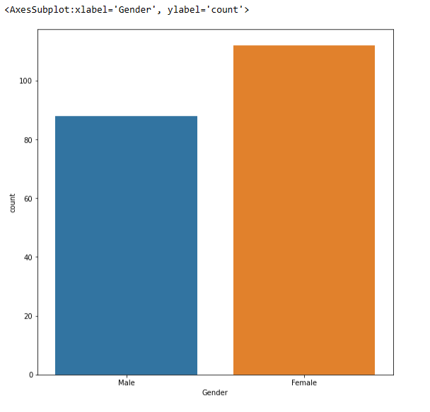
Implementation
Gender Plot
Gender Plot Analysis:
From the Count plot, it is observed that the number of Female customers is more than the total number of Male customers.

Slide 16
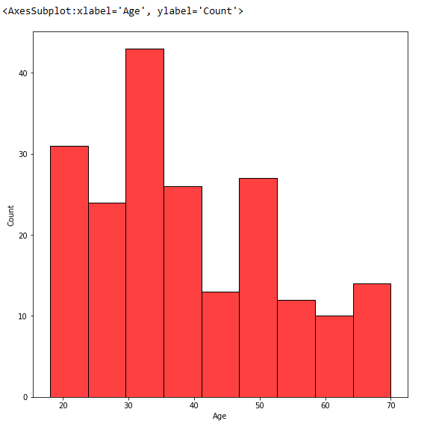
Age Plot
Age Plot Analysis:
From the Histogram it is evident that there are 3 age groups that are more frequently shop at the mall, they are: 15-22 years, 30-40 years, and 45-50 years.

Slide 17
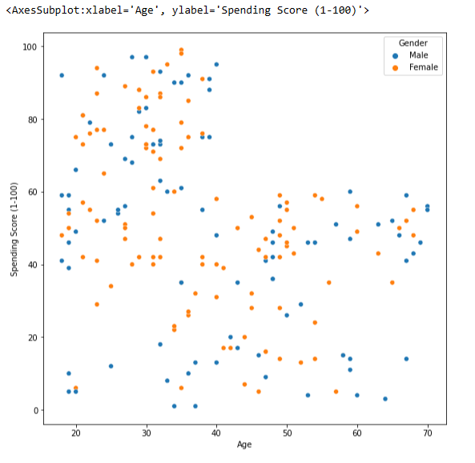
Age vs Spending Score
Age Vs Spending Score Analysis
From the Age Vs Spending Score plot we observe that customers whose spending score is more than 65 have their Age in the range of 15-42 years. Also, from the Scatter plot it is observed that customers whose spending score is more than 65 consists of more Females than Males.
The customers having average spending score ie: in the range of 40-60 consists of the age group of the range 15-75 years and the count of males and females in this age group is also approximately the same.

Slide 18
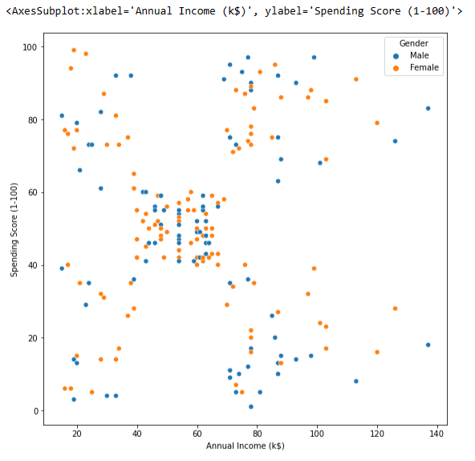
Annual Income vs Spending Score
Annual Income Vs Spending Score Analysis
We observe that there are 5 clusters and can be categorized as:
High Income, High Spending Score (Top Right Cluster)
High Income, Low Spending Score
(Bottom Right Cluster)
Average Income, Average Spending Score
(Center Cluster)
Low Income, High Spending Score (Top Left Cluster)
Low Income, Low Spending Score
(Bottom Left Cluster)

Slide 19
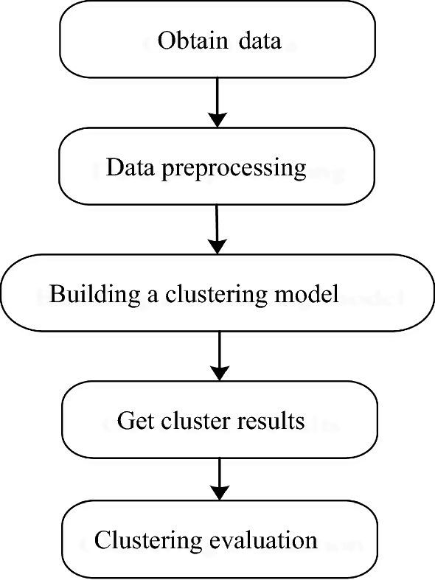
Work Flow

Slide 20
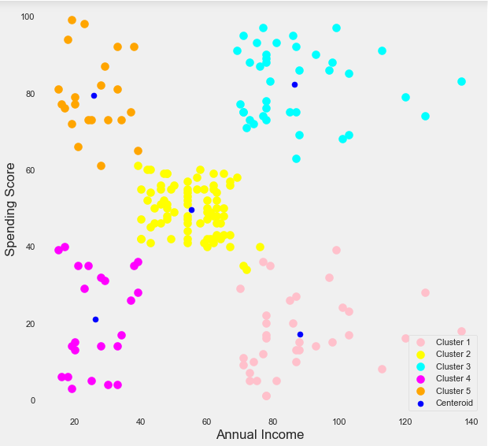
Conclusion
High Income, High Spending Score (Cluster 5) - Target these customers by sending new product alerts which would lead to an increase in the revenue collected by the mall as they are loyal customers.
High Income, Low Spending Score (Cluster 2) - Target these customers by asking the feedback and advertising the product in a better way to convert them into Cluster 5 customers.
Average Income, Average Spending Score (Cluster 1) - May or may not target these groups of customers based on the policy of the mall.
Low Income, High Spending Score (Cluster 4) - Can target these set of customers by providing them with Low-cost EMI's, etc.
Low Income, Low Spending Score (Cluster 3) - Don't target these customers since they have less income and need to save money.

Slide 21
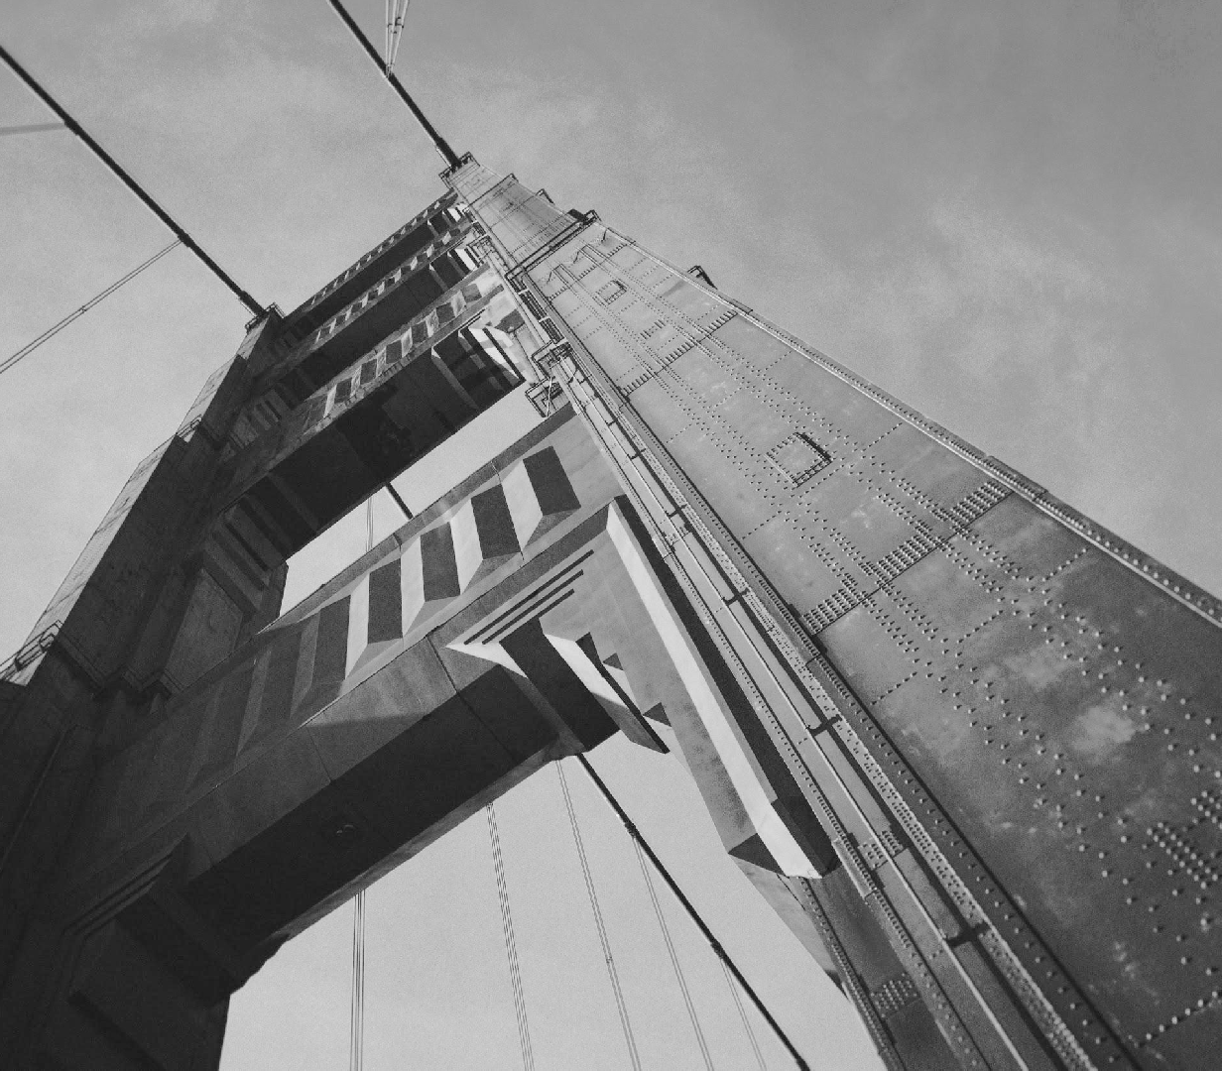
Thank you

